Slide 1
ONC Move Health Data Forward Challenge
Q&A Webinar
August 18, 2016

Slide 2

On Today’s Call
Challenge Team:
Caroline Coy, Office of the National Coordinator for Health IT
Adam Wong, Office of the National Coordinator for Health IT
Debbie Bucci, Office of the National Coordinator for Health IT
Agenda:
ONC Overview
Define the Problem
Market Information
Challenge Overview
The HEART WG
Phase Overview
Submission Requirements and How to Apply
Phase 1 Evaluation Criteria
Timeline
Q & A

Slide 3
Office of the National Coordinator of Health IT (ONC)
The Office of the National Coordinator for Health Information Technology (ONC) is at the forefront of the administration’s health IT efforts and is a resource to the entire health system to support the adoption of health information technology and the promotion of nationwide health information exchange to improve health care.
ONC is organizationally located within the Office of the Secretary for the U.S. Department of Health and Human Services (HHS).
ONC is the principal federal entity charged with coordination of nationwide efforts to implement and use the most advanced health information technology and the electronic exchange of health information

Slide 4
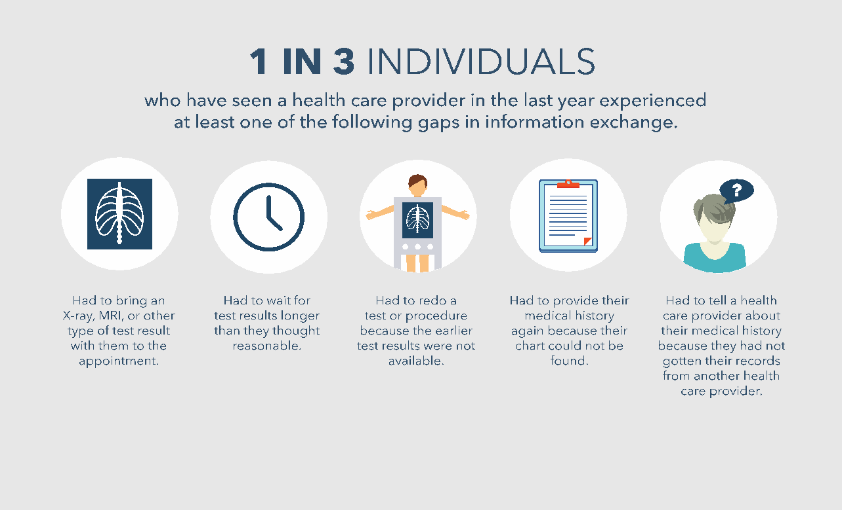
Individuals Experience Gaps in Health Information Exchange
Source: http://www.nejm.org/doi/pdf/10.1056/NEJMsa063979

Slide 5
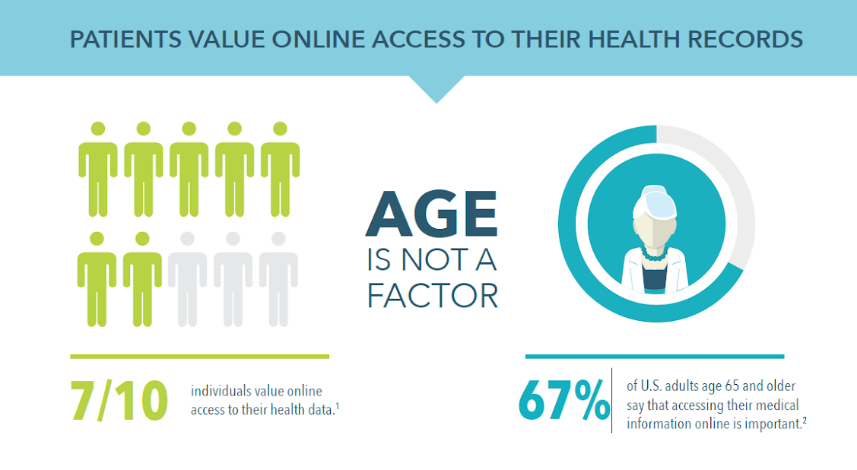
Value of Online Access

Slide 6

Individuals are Viewing their Health Records Online
Sources: http://www.nejm.org/doi/pdf/10.1056/NEJMsa063979
http://www.nationalpartnership.org/research-library/health-care/HIT/engaging-patients-and-families.pdf

Slide 7
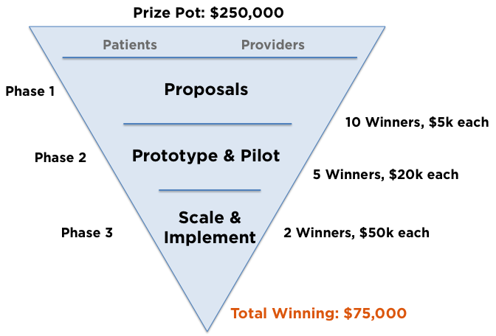
MHDF Challenge Overview
The Move Health Data Forward Challenge aims to promote the development of technology solutions that can enable consumers to authorize the movement of their health data to destinations they choose.

Slide 8
General Requirements
Participants are tasked to develop a technological solution to help authorize the movement of health data.
Participants are expected to engage people to test the implementation of the Solution and make possible processes for consumers to authorize the release of their health data to a destination they choose.
The data for the API and solution should be provided by challenge finalists.
This Challenge encourages applicants to apply independently or team with others including health IT developers, health care providers and other entities with the appropriate expertise related to this solution.

Slide 9
Eligibility Requirements – FAQ’s
Applicants must meet all eligibility requirements to be eligible for a prize. Full eligibility rules are available in the Federal Register Notice (here)
Eligibility FAQ’s
Private entities MUST be incorporated in the US to be eligible for a prize
Submissions should not include HHS or ONC logos, official seals, or imply endorsement
Applicants retain ownership and all IP rights, but irrevocably grant the Government a limited, non-exclusive, royalty-free, perpetual, worldwide license

Slide 10
The HEART WG
ONC has collaborated to launch the Health Relationship Trust Working Group (HEART WG)
HEART WG is developing a set of privacy and security specifications to empower people to control the authorization of access to health-related data sharing APIs, using the following open standards:
OAUTH 2.0
OpenID Connect
User Managed Access (UMA)
Challenge teams will test HEART technology and create an open API that enables heath data sharing.
http://openid.net/wg/heart/

Slide 11
Phase Overview
Phase 1: Proposal
Present Solutions that increase consumers’ access to and sharing of their information within electronic health record systems.
Should describe the team and the technical, operational, financial and business aspects of their proposed Solution.
Phase 2: Prototype
Phase 1 finalists will advance to a second phase focused on prototyping and demonstrating the effectiveness of the Solution.
Should display the impact on consumer or provider health records accessibility and data exchange.
Phase 3: Testing
Involves testing the Solution in “real-life” situations.
Will also test the scalability of the Solution, the feasibility of implementation, and the impact of the intended outcomes.

Slide 12
Phase 1: Proposal Submission Requirements
Purpose
For participants should describe the technical, operational, financial and business aspects of their proposed Solution.
What to Submit
General information about the participants and any team members
Compliance with Health Insurance Portability and Accountability Act (HIPAA)
Business Case (5 page maximum)
Briefing Deck Presentation (10 slides maximum)

Slide 13
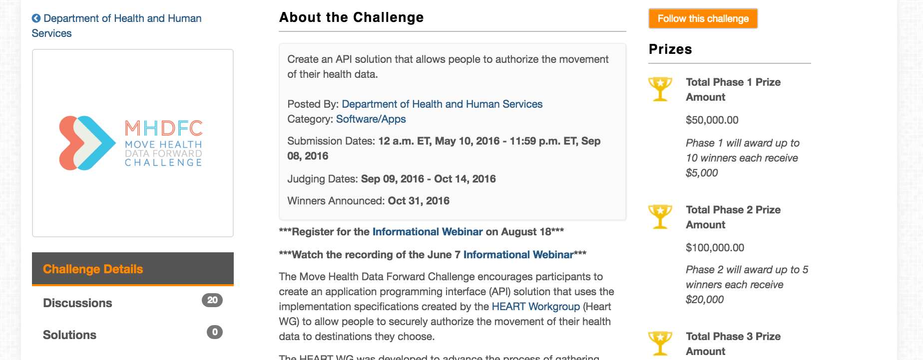
How to Apply
Challenge.gov
All applications must be submitted on Challenge.gov
Challenge.gov is free to register
Applicant must be logged in to Challenge.gov to submit solution
No separate registration for the challenge is required, however you may wish to ‘Follow’ the challenge to receive reminders and updates

Slide 14
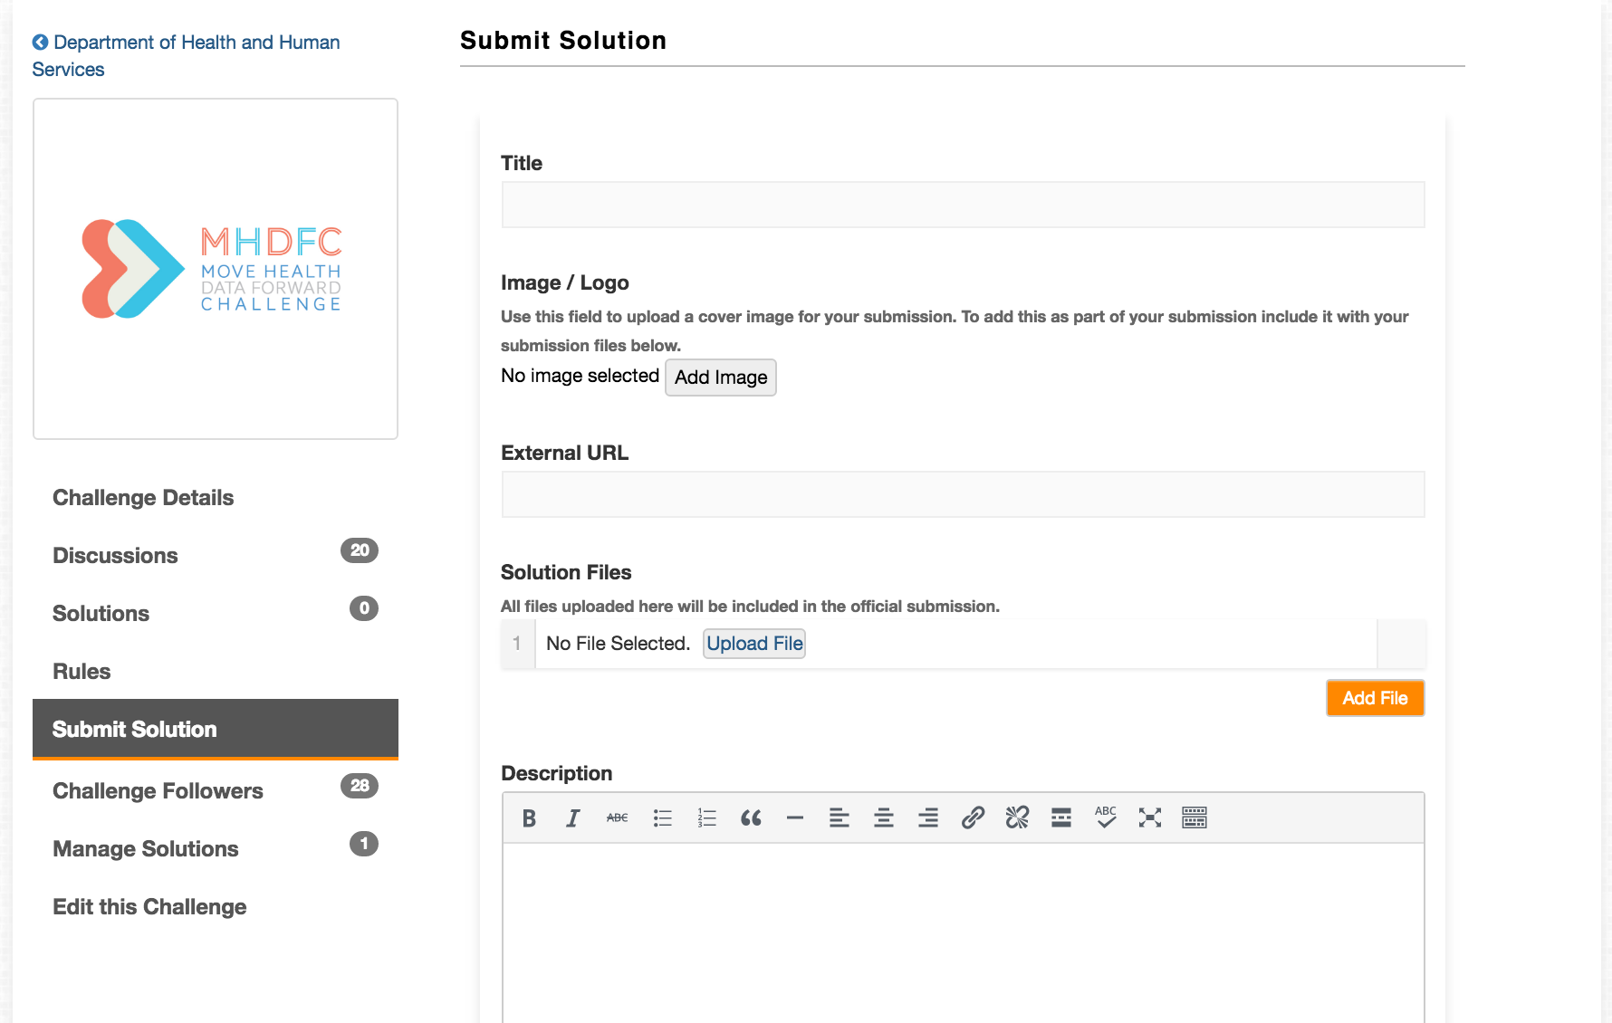
How to Apply
Submissions are open until 11:59pm September 8, 2016
Go to https://www.challenge.gov/challenge/move-health-data-forward-challenge/
Select Submit Solution

Slide 15
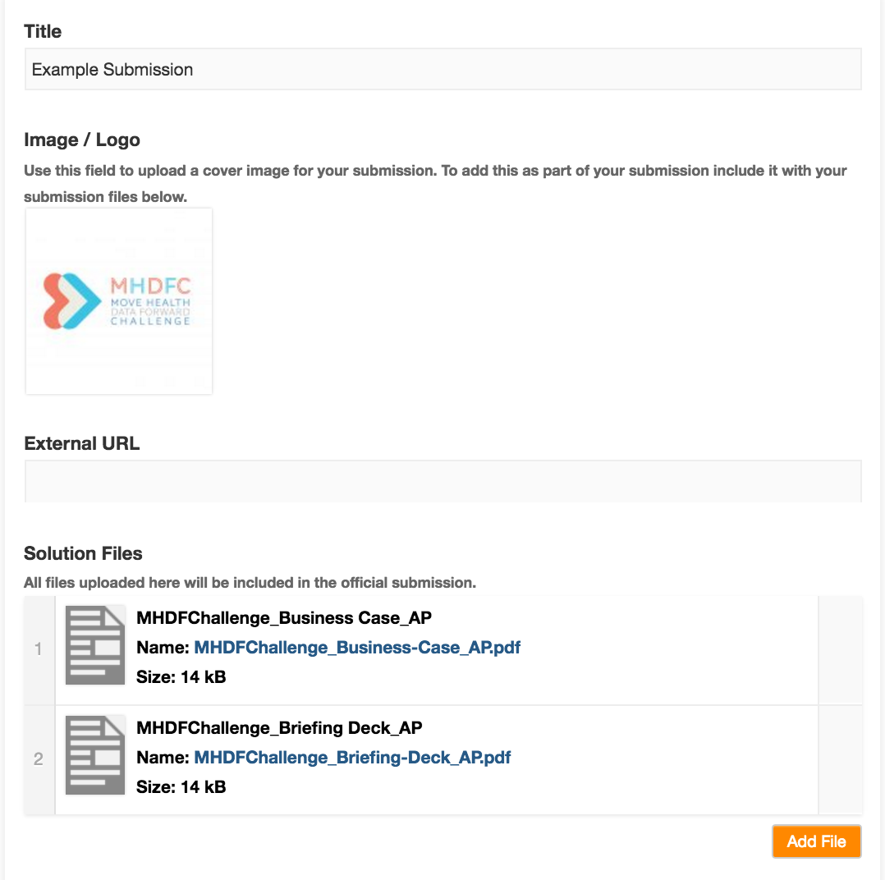
How to Apply
Enter Submission Title
Upload Image/Logo (optional)
External URL (optional)
Example: a link to the website of the existing corporation
Link should not go to significant/required content
Upload Business Case and Briefing Deck in PDF format

Slide 16
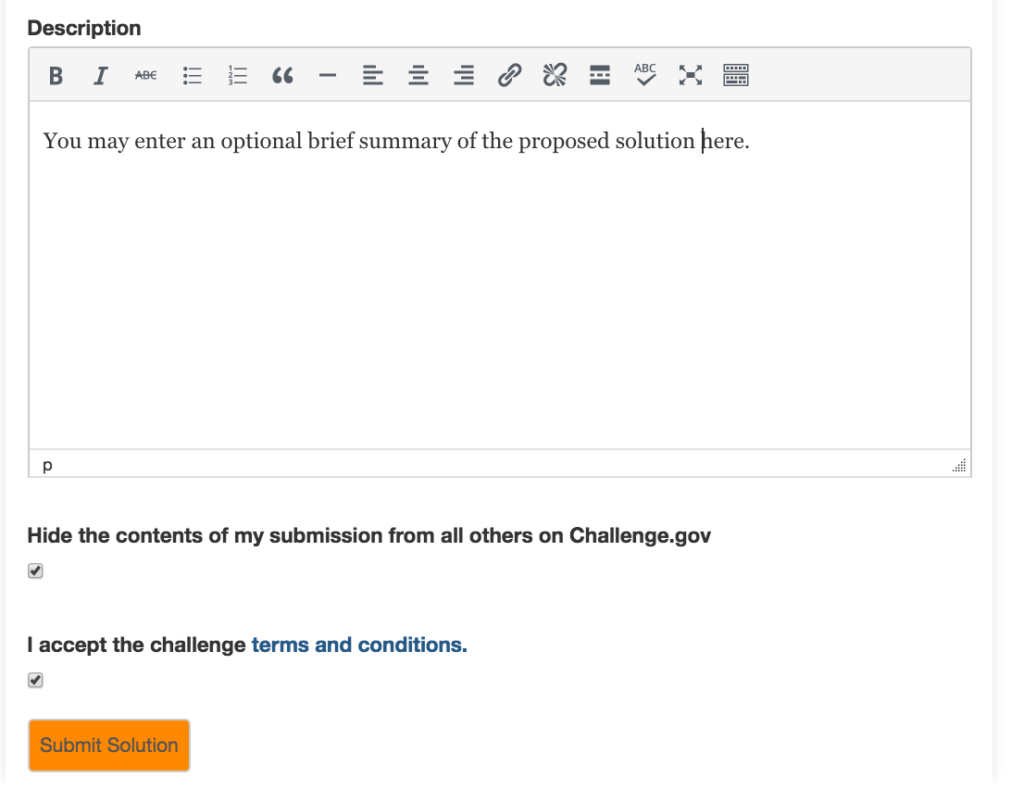
How to Apply
Enter brief summary (optional)
Hide contents of submission (optional)
Accept terms and conditions
Applicant is required to ensure they meet all eligibility requirements to prevent disqualification – see “Rules” section for further information
Submit Solution

Slide 17
Phase 1: Proposal Business Case Content
Executive summary stating the value proposition
Description of the methods and technologies used to develop the Solution
Financial overview
Development plan and timeline
Metrics for success defined by applicant (i.e. Number of users of the Solution, money saved by using the Solution, etc.)
Potential risks and mitigation strategies, including security constraints
Description of the participant roles, responsibilities and capabilities

Slide 18
Phase 1: Proposal Business Case Requirements
Length
Should not exceed 5 pages, with font size no smaller than 8pt font and ‘normal’ 1” margins
Accepted Format
PDF
Risk/Insurance
Since the Challenge deals with consumer health data a reasonable accounting of how the solver will deal with risk, insurance considerations should be included
Examples
Business case templates are available online and can serve as guide (use at your own discretion)

Slide 19
Phase 1: Briefing Deck Content
Brief description of proposed Solution and how the participants will use the HEART implementation specifications for consumer-mediated exchange of health information
Competitive advantage of the approach
Example use case
Proposed workflow & deliverables

Slide 20
Phase 1: Briefing Deck Requirements
Length
Should not exceed 10 slides. Slides should be of reasonable size with legible font size
Accepted Format
PDF
External Links
Links can be used, but should not add significant content
Good: Link to published articles that further support methodology
Bad: Link to proposed workflow to save slides
Examples
Briefing deck and lightning pitch templates are available online and can serve as a guide (use at your own discretion)

Slide 21

Phase 1 Evaluation Criteria
Participant Capabilities
Is there appropriate expertise and capability to bring the idea to the testing stage?
Does the participant have the resources available to carry out proposed work?
Notes:
Break into 3 slides, add images as necessary

Slide 22

Phase 1 Evaluation Criteria
Impact Potential
Does the proposed Solution have potential to improve the quality of health care?
Does the Submission describe how the Solution can be optimized for the greater population of consumers and/or providers?
Is there a clear plan to make the Solution readily available to consumers on existing mobile platforms or a public-facing website?
Is the Solution relevant to ONC priorities of improving the quality of health care?
Notes:
Break into 3 slides, add images as necessary

Slide 23

Phase 1 Evaluation Criteria
Executability
Does the Solution demonstrate its HIPAA compliance?
Does the Solution utilize the HEART implementation specifications?
Does the Submission demonstrate a reasonable and credible approach to accomplish the proposed objectives, tasks, outcomes and deliverable?
Does the Submission address a pathway or timeline to broad use?
Does the Submission clearly define potential risks?
Does the Submission include a thorough description for the use of funds?

Slide 24
Challenge Timeline
Phase 1:
Challenge launch: May 10, 2016
Submissions due: September 8, 2016
Evaluation period: September 9—October 14, 2016
Phase 1 winners announced: October 31, 2016
Phase 2:
Prototyping period begins: October 31, 2016
Submissions due: January 12, 2017
Evaluation period: January 12—February 10, 2017
Phase 2 winners announced: February 23, 2017
Phase 3:
Scaling period begins: February 23, 2017
Submission period ends: May 1, 2017
Phase 3 winners announced: May 31, 2017

Slide 25
Questions?
Join the Discussion
https://www.challenge.gov/challenge/move-health-data-forward-challenge/
More questions?
Check out or Post on our Discussions Page!
ONC.TechLab@hhs.gov

